Slide 1
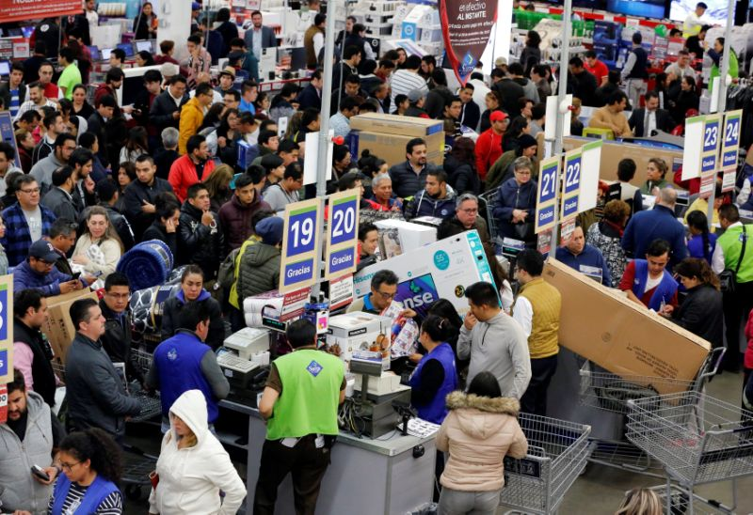
Black Friday Customer Purchase Prediction
by: Farzad Radmehr

Slide 2

Output: Purchase
Inputs:
Gender
Age
Occupation
City Category
# of years of staying in current city
Product Category 1
Product Category 2
Product Category 3

Slide 3
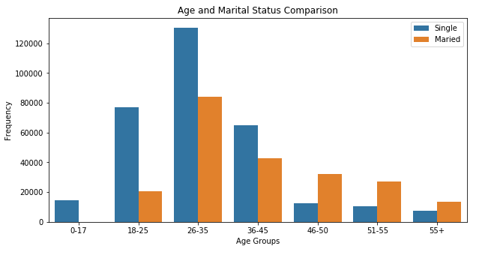
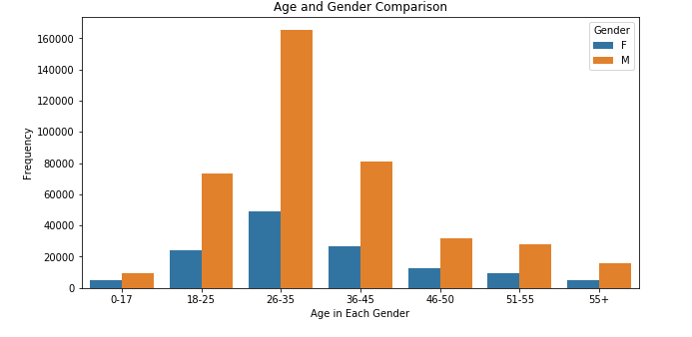
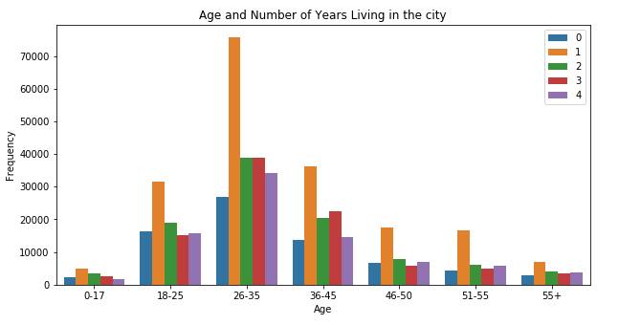
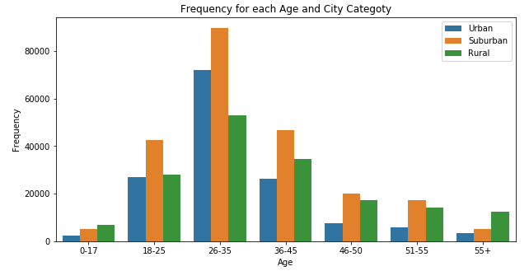

Slide 4
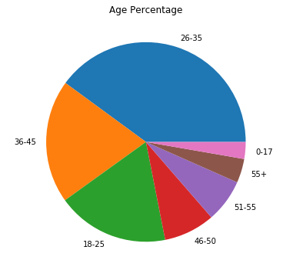
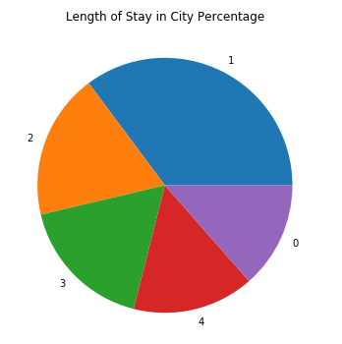
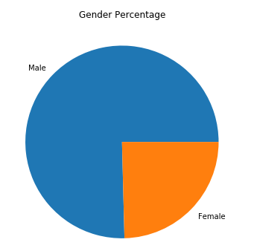
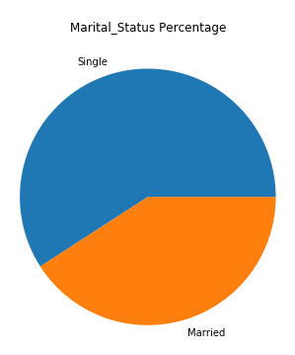

Slide 5
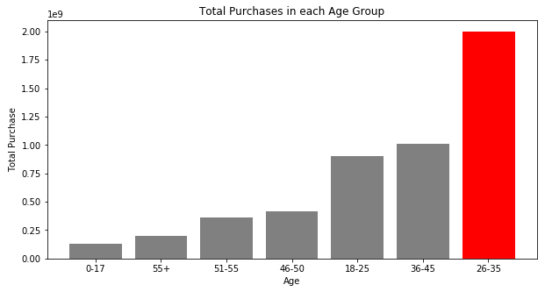
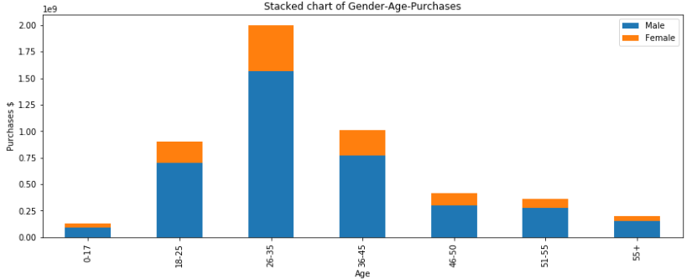
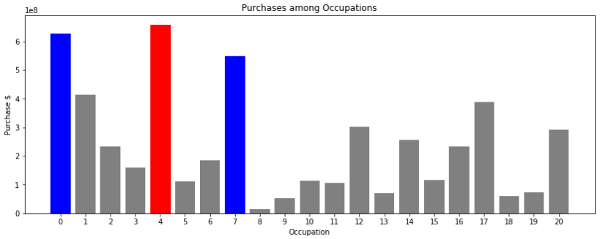

Slide 6
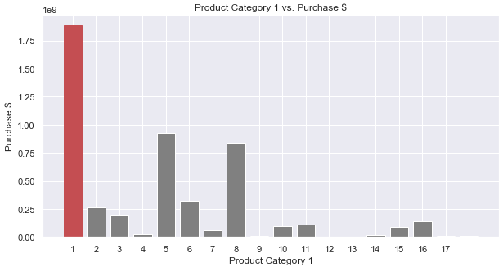
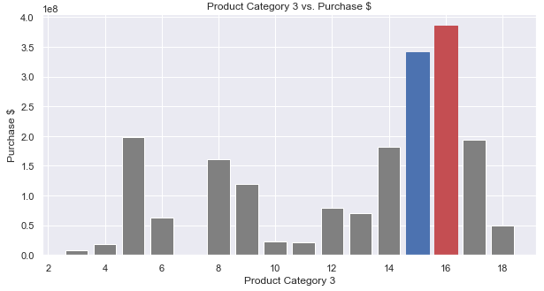
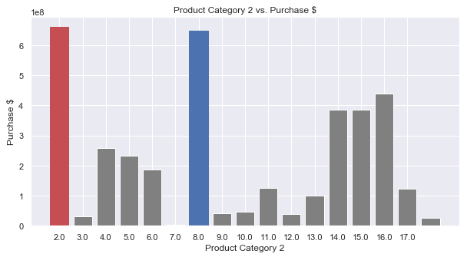

Slide 7

People from rural areas pay significantly higher.
People in age group 26-35 significantly paid highest.
No difference between single and married.
product category 3 has the highest impact on total purchases.
Categories | Results 1 | Results 2
Product Category 1 | Women are signicantly more interested | Singles are significantly more interested
Product Category 2 | Both men and women have same interests | Both singles and married ones have same interest
Product Category 3 | Men are signifantly more interested | singles are signicantly more interested

Slide 8

Machine Learning Techniques
Method | Features | Parameters | Training RMSE | Test RMSE
Linear Regression | Gender, Age, Occupation, City Category, Current City # of years, Marital Status, Product Category 1,2,3 | Test % = 30, Random State = 42 | 4630.9 | 4633.8
Decision Tree Regressor | Gender, Age, Occupation, City Category, Current City # of years, Marital Status, Product Category 1,2,3 | Test % = 30, Random State = 42 | 2960.2 | 2983.8
Random Forest Regressor | Gender, Age, Occupation, City Category, Current City # of years, Marital Status, Product Category 1,2,3 | Test % = 30, Random State = 42 | 2945.1 | 2968.4

